Slide 1

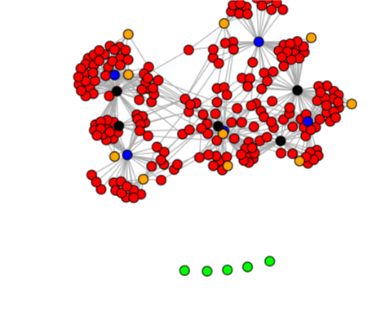



Intro to the R packages seedHealth and INApreliminary
Karen A. Garrett
karengarrett@ufl.edu
garrettlab.com
@Garrett_Lab

Slide 2

seedHealth
R package
Contributors include: K. A. Garrett, S. Thomas-Sharma, K. F. Andersen, Y. Xing, R. I. Alcalá-Briseño, J. Andrade-Piedra , R. A. Choudhury, W. Dantes, J. Fayette, G. A. Forbes, J. F. Hernandez Nopsa, I. Navarrete, K. Ogero, J. Yuen

Slide 3

[link]
Sara Thomas-Sharma

Slide 4
[open access link]
2017
This paper introduces the model framework and summarizes the parameter space for seed degeneration in general
The seedHealth package allows users to evaluate specific cases: hypothetical or observed
Sara Thomas-Sharma
Online interface available: [Interactive interface for exploring model behavior]

Slide 5
System components included in the seedHealth model
Thomas-Sharma et al. 2017

Slide 6
Addressing questions such as
For the scenarios considered in a given field study, how frequently is it profitable for farmers to purchase formal seed?
In an integrated seed health strategy for these scenarios, what combinations of management components work well?

Slide 7
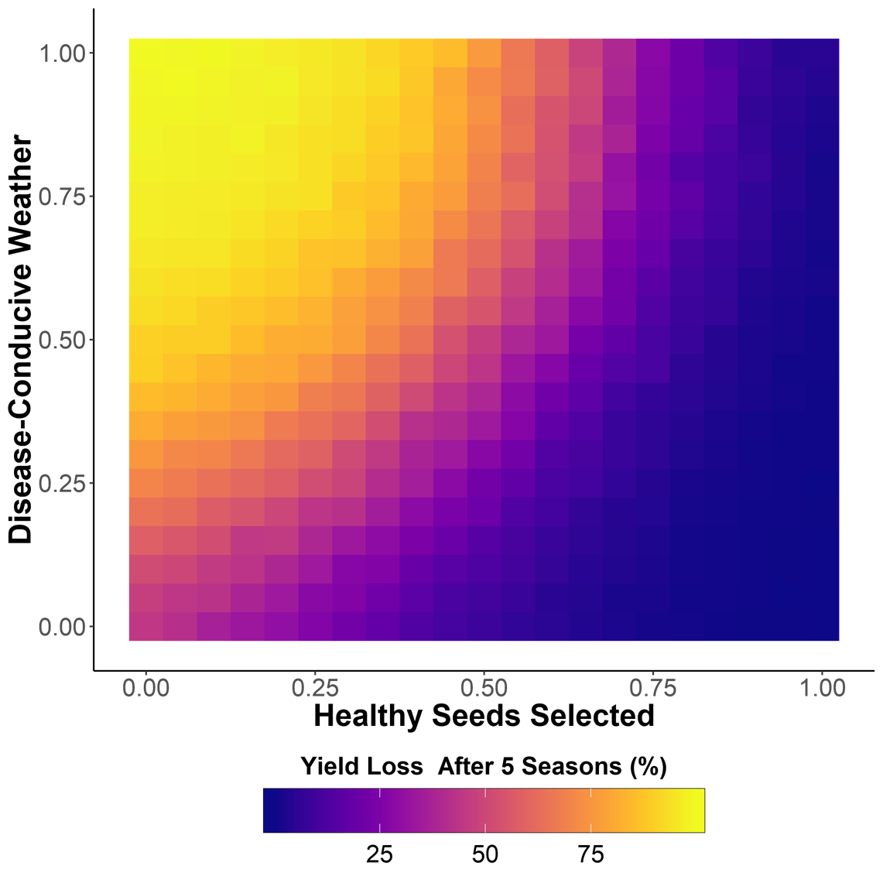
Output from seedHealth
It also summarizes outcomes across a range of parameter values, to compare scenarios and as part of uncertainty analyses (below).
seedHealth provides a time series of likely disease incidence or yield loss, based on user input about the system (below).

Slide 8
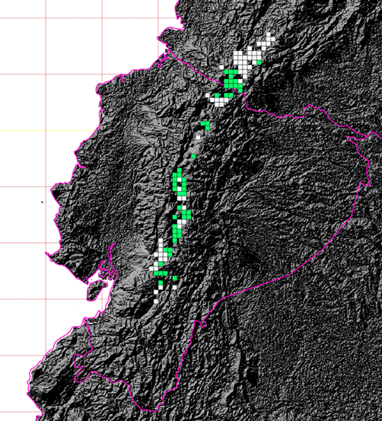

Management performance mapping: the value of information for regional prioritization of project interventions
C. E. Buddenhagen, J. Andrade Piedra, G. A. Forbes, P. Kromann, I. Navarrete, S. Thomas-Sharma, Y. Xing, K. A. Garrett
bioRxiv 2018
Generation of maps of [seed health] management performance for donors/funders deciding on prioritization for investment, extension agents deciding on priorities, etc.
Higher and lower elevation areas in Ecuador and Colombia, with distinct effects of positive selection on yield
Chris Buddenhagen

Slide 9
seedHealth manuscript
A manuscript on seedHealth (in preparation) also addresses good and optimal data sets and experimental designs – other contributors to this manuscript are welcome
NOTE: one very important step is determining how to make the best use of existing data to develop parameter estimates to use in the seedHealth model

Slide 10
INApreliminary

Slide 12
Garrett et al 2018 ARP

Slide 13
Garrett et al 2018 ARP

Slide 14
“impact network analysis” versus “network analysis” 1
“Network analysis” encompasses a lot of types of analyses
The simplest type of network analysis might be to estimate what nodes (e.g., farmers) and links (e.g., exchange of seed) are present in a system
Answers the question: What is the structure of the system?
INA provides scenario analyses to address questions about information/technology impacts based on linked networks
Answers the question: What are the implications of the structure of the system for important system outcomes?

Slide 15
“impact network analysis” versus “network analysis” 2
Characterizing networks is a first step for INA
For example, using seed tracker, seed flow mapping, seed tracing
INA can be a considered a type of network analysis
(like multivariate analysis is a type of statistical analysis)
Is INA a distinct tool? (Or is INA any type of network analysis that we want?)
It is a distinct tool in the sense that it addresses a set of questions, data types, and system types common to researchers interested in invasion biology, management decisions, and economic exchange – like seed systems
(and distinct in the sense of being a set of R functions)

Slide 16




Epidemic network analysis for mitigation of invasive pathogens in seed systems: Potato in Ecuador
Addresses gender using exponential random graph models
Phytopathology 2017
C. E. Buddenhagen*, J. F. Hernandez Nopsa*, K. F. Andersen, J. Andrade-Piedra, G. A. Forbes, P. Kromann, S. Thomas-Sharma, P. Useche, K. A. Garrett
[open access link]

Slide 17
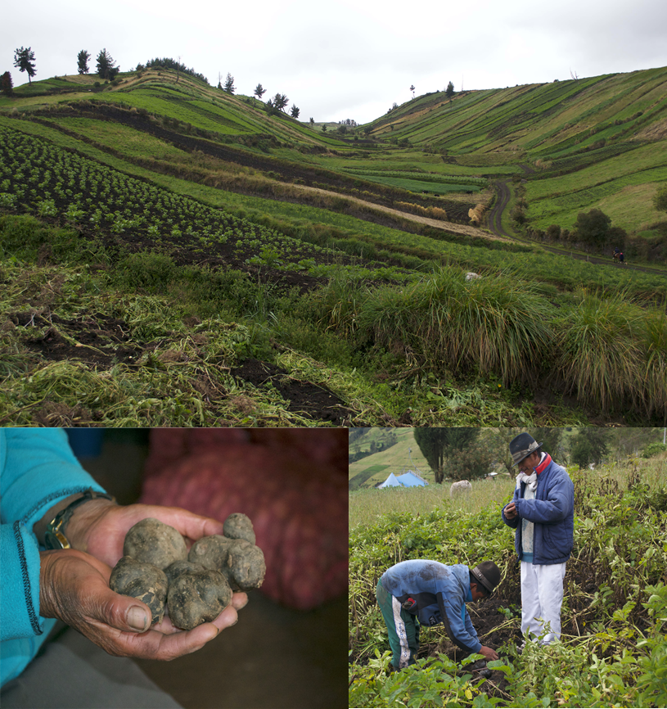
Potato production in Tungurahua Province, Ecuador
Photos: J Hernandez Nopsa
In this analysis, we have survey data for both potato transactions and sources of information for IPM

Slide 18
Scenario analysis indicating how effective monitoring of the spread of a pathogen would be at each node, based on location in network and IPM information sources
Buddenhagen, Hernandez Nopsa, et al. 2017

Slide 19
Phytopathology 2017
[open access link]
Cross-crop analysis
An opportunity for linking crop breeding and seed systems in follow-up studies

Slide 20
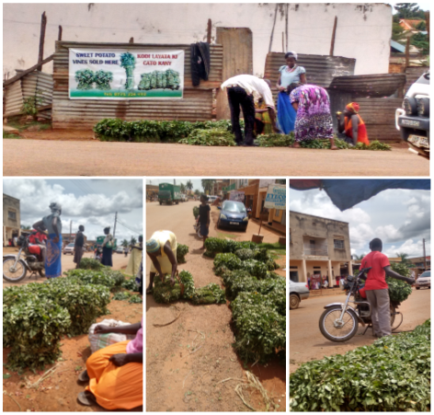

Modeling epidemics in seed systems and landscapes to guide management strategies: The case of sweetpotato in Northern Uganda
K. F. Andersen, C. E. Buddenhagen, P. Rachkara, R. Gibson,
S. Kalule, D. Phillips, and K. A. Garrett
Phytopathology 2019
Code from analyses in this paper is available at
https://github.com/kelseyandersen/ugsweets
Kelsey Andersen

Slide 21
Experiment 1: The value of villages as risk-based surveillance locations

Slide 22
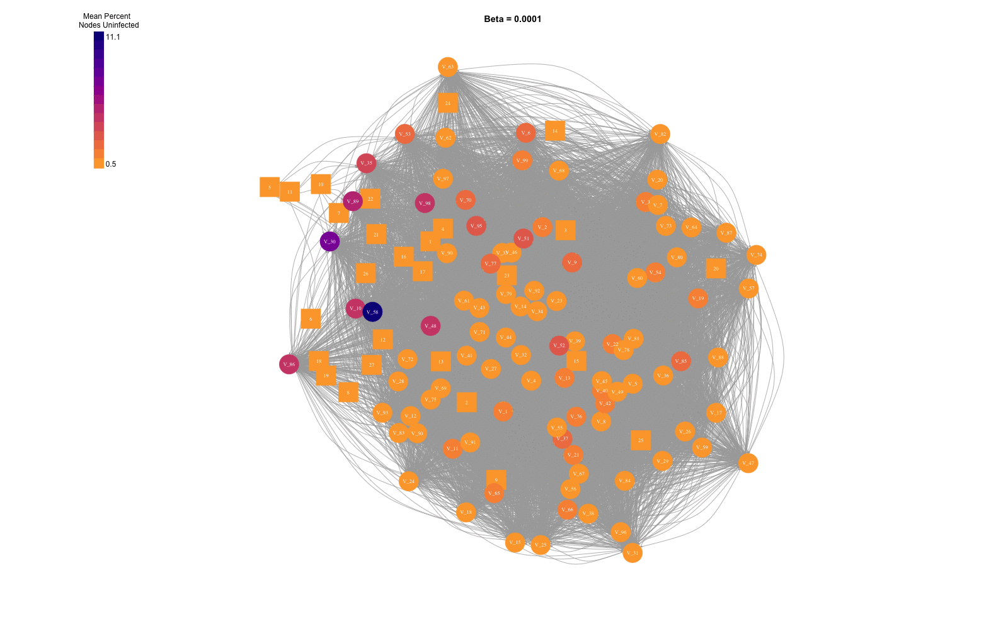
Sensitivity of results to spread parameter

Slide 23
At intermediate values, the rank of locations as risk based surveillance locations is similar
Spearman’s rank correlation for Surveillance Scores across parameter values for spread parameters λ & β.

Slide 24
Andersen et al. 2019 includes several other analyses that could be useful in your studies
The example code we will look at in INApreliminary looks at which locations in a network are most important for sampling to detect an epidemic (or diffusion of a crop variety) while it is still in the early stages of spread
The paper also includes
Several types of sensitivity analyses
Identification of the nodes most important for stopping the spread of an epidemic (or increasing the spread of a crop variety)
Testing comparison of methods for identifying key nodes in a given types of network
The code is available at
https://github.com/kelseyandersen/ugsweets

